Slide 1

COMPUTER ORGANIZATION AND ARCHITECTURE
M. Grace Mercy
Asst. Professor
Dept. of EECE, GIT
Visakhapatnam
gmatta@gitam.edu

Slide 2
UNIT III
Central Processing Unit: Introduction, general register organization, stack organization, instruction formats, addressing modes, data transfer and manipulation, program control.
Pipeline and Parallel Processing: Parallel processing, pipelining, arithmetic pipeline, instruction pipeline.
Computer Arithmetic: Introduction, addition and subtraction, decimal arithmetic unit, Booth’s multiplication algorithm.

Slide 3
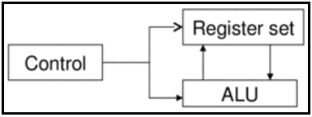
Central Processing Unit
The part of the computer that performs the bulk of data-processing operations is called the central processing unit and is referred to as the CPU.
The CPU is made up of three major parts, as shown in Figure.
The register set stores intermediate data used during the execution of the instructions.
The arithmetic logic unit (ALU) performs the required microoperations for executing the instructions.
The control unit supervises the transfer of information among the registers and instructs the ALU as to which operation to perform.
Notes:
The CPU performs a variety of functions dictated by the type of instructions that are incorporated in the computer.
Computer architecture is sometimes defined as the computer structure and behavior as seen by the programmer that uses machine language instructions.
This includes the instruction formats, addressing modes, the instruction set, and the general organization of the CPU registers.
One boundary where the computer designer and the computer programmer see the same machine is the part of the CPU associated with the instruction set.
From the designer's point of view, the computer instruction set provides the specifications for the design of the CPU.
The design of a CPU is a task that in large part involves choosing the hardware for implementing the machine instructions.
The user who programs the computer in machine or assembly language must be aware of the register set, the memory structure, the type of data supported by the instructions, and the function that each instruction performs.

Slide 4
General Register Organization
Memory locations are needed for storing pointers, counters, return addresses, temporary results, and partial products during multiplication.
Having to refer to memory locations for such applications is time consuming because memory access is the most time-consuming, operation in a computer.
It is more convenient and more efficient to store these intermediate values in processor registers.
When a large number of registers are included in the CPU, it is most efficient to connect them through a common bus system. The registers communicate with each other not only for direct data transfers, but also while performing various microoperations.
Hence it is necessary to provide a common unit that can perform all the arithmetic, logic, and shift microoperations in the processor.

Slide 5
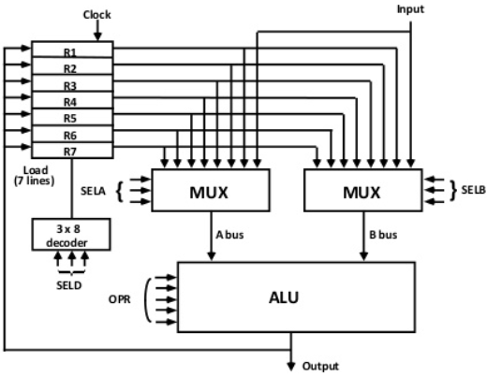
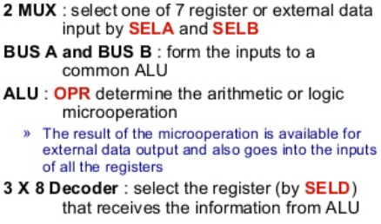
General Register Organization
A bus organization for seven CPU registers is shown in Fig.

Slide 6
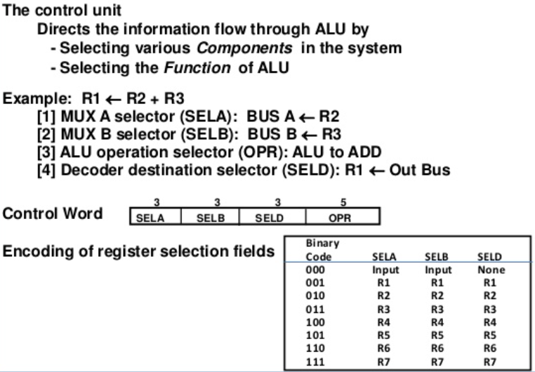
Operation of Control Unit

Slide 7
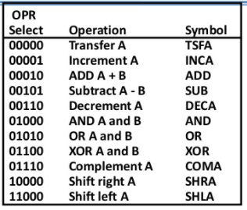
ALU Control
Encoding of ALU operation

Slide 8
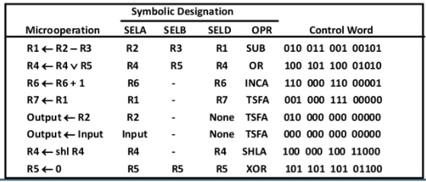
Examples of ALU microperations

Slide 9
Thank you

Slide 10
Stack Organization
A useful feature that is included in the CPU of most computers is a stack or last-in, first-out (LIFO) list.
A stack is a storage device that stores information in such a manner that the item stored last is the first item retrieved.
The operation of a stack can be compared to a stack of trays. The last tray placed on top of the stack is the first to be taken off.
The stack in digital computers is essentially a memory unit with an address register that can count only (after an initial value is loaded into it).
The register that holds the address for the stack is called a stack pointer (SP) because its value always points at the top item in the stack.

Slide 11
Stack Organization
The two operations of a stack are the insertion and deletion of items.
The operation of insertion is called push (or push-down) because it can be thought of as the result of pushing a new item on top.
The operation of deletion is called pop (or pop-up) because it can be thought of as the result of removing one item so that the stack pops up. These operations are simulated by incrementing or decrementing the stack pointer register.

Slide 12
Stack Organization
Stack or LIFO(Last-In, First-Out)
A storage device that stores information
Very useful feature for nested subroutines, nested loops control
The item stored last is the first item retrieved = a stack of tray
Stack Pointer (SP)
The register that holds the address for the stack
SP always points at the top item in the stack
Two Operations of a stack : Insertion and Deletion of Items
PUSH : Push-Down = Insertion
POP : Pop-Up = Deletion
Stack
1) Register Stack (Stack Depth → a finite number of memory words or register(stand alone)
2) Memory Stack (Stack Depth → a portion of a large memory

Slide 13
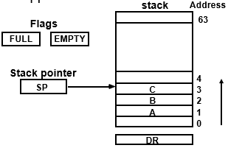
Register Stack
Initially, SP = 0, EMPTY = 1, FULL = 0

Slide 14
Register Stack
Initially, SP = 0, EMPTY = 1, FULL = 0
PUSH operation → Writing into stack
If (FULL=0) ; check if stack is not full
SP ← SP + 1 ;Increment stack pointer M[SP] ← DR ; Write item on top of the stack
If (SP = 0) then (FULL ← 1) ; Check if stack is full
EMPTY ← 0 ; Mark the stack not empty

Slide 15
Register Stack
POP operation → Reading from stack
If (EMPTY = 0)
DR ← M[SP] ; Read item from the top of stack
SP ← SP – 1 ; Decrement stack pointer
If (SP = 0) then (EMPTY ← 1) ; Check if stack is empty
FULL ← 0 ; Mark the stack not full

Slide 16
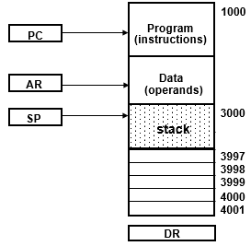
Memory Stack
A portion of memory is used as a stack with a processor register as a stack pointer.
The first item is stored at address 4000 → SP =4001
PUSH: SP ← SP - 1
M[SP] ← DR
POP: DR ← M[SP]
SP ← SP + 1

Slide 17
Memory Stack
Most computers do not provide hardware to check stack overflow (full stack) or underflow(empty stack) → Must be done in software.
Stack Limits:
Check for stack overflow(full)/underflow(empty)
Checked by using two register
Upper Limit and Lower Limit Register
After PUSH Operation → SP compared with the upper limit register
After POP Operation → SP compared with the lower limit register

Slide 18
Reverse Polish Notation
A stack organization is very effective for evaluating arithmetic expressions.
The common mathematical method of writing arithmetic expressions imposes difficulties when evaluated by a computer.
The common arithmetic expressions are written in infix notation, with each operator written between the operands.
A + B → Infix notation
+ AB → Prefix or Polish notation
AB + → Postfix or reverse Polish notation
The reverse Polish notation is in a form suitable for stack manipulation.
The expression A • B + C • D is written in reverse Polish notation as AB • CD • +
Notes:
Evaluation: Scan the expression from left to right. When an
operator is reached, perform the operation with the two operands found on
the left side of the operator. Remove the two operands and the operator and
replace them by the number obtained from the result of the operation. Continue
to scan the expression and repeat the procedure for every operator
encountered until there are no more operators.

Slide 19
conversion from infix notation to reverse Polish notation
Consider the expression (A + B) • [C • (D + E) + f]
first perform the arithmetic inside the parentheses (A + B) and (D + E).
AB + DE + C • F + •

Slide 20
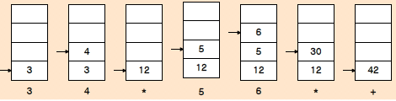
Evaluation of Arithmetic Expressions
Reverse Polish notation, combined with a stack arrangement of registers, is the most efficient way known for evaluating arithmetic expressions.
Consider the arithmetic expression (3 * 4) + (5 * 6)
In reverse Polish notation, it is expressed as 34 • 56 • +

Slide 21
Thank you

Slide 22
Instruction Formats
A computer usually has a variety of instruction code formats. It is the function of the control unit within the CPU to interpret each instruction code and provide the necessary control functions needed to process the instruction.
The format of an instruction is usually depicted in a rectangular box symbolizing the bits of the instruction as they appear in memory words or in a control register.
The bits of the instruction are divided into groups called fields.
The most common fields found in instruction formats are:
An operation code field that specifies the operation to be performed.
An address field that designates a memory address or a processor register.
A mode field that specifies the way the operand or the effective address is determined.
Other special fields are sometimes employed under certain circumstances, as for example a field that gives the number of shifts in a shift-type instruction.

Slide 23
Instruction Formats
The operation code field of an instruction is a group of bits that define various processor operations, such as add, subtract, complement, and shift.
The bits that define the mode field of an instruction code specify a variety of alternatives for choosing the operands from the given address.
Operations specified by computer instructions are executed on some data stored in memory or processor registers. Operands residing in memory are specified by their memory address. Operands residing in processor registers are specified with a register address.
A register address is a binary number of k bits that defines one of '2^{k}' registers in the CPU. Thus a CPU with 16 processor registers R0 through R15 will have a register address field of four bits. The binary number 0101, for example, will designate register R5.
Computers may have instructions of several different lengths containing varying number of addresses. The number of address fields in the instruction format of a computer depends on the internal organization of its registers.

Slide 24
Instruction Formats
Most computers fall into one of three types of CPU organizations:
1. Single accumulator organization: Ex. ADD X (AC ← AC + M[X ])
2. General register organization: Ex. ADD R1, R2, R3 (R1← R2 + R3)
3. Stack organization: PUSH X (TOS ← M[X ])
In an accumulator-type organization all operations are performed with an implied accumulator register. The instruction format in this type of computer uses one address field.
For example, the instruction that specifies an arithmetic addition is defined by an assembly language instruction as ADD X where X is the address of the operand. The ADD instruction in this case results in the operation AC ← AC + M [X].
AC is the accumulator register and M [X] symbolizes the memory word located at addresX.

Slide 25
Instruction Formats
In a general register type of organization the instruction format in this type of computer needs three register address fields.
Thus the instruction for an arithmetic addition may be written in an assembly language as ADD R1 , R2 , R3 to denote the operation R1 ← R2 + R3.
The number of address fields in the instruction can be reduced from three to two if the destination register is the same as one of the source registers.
Thus the instruction ADD R1 , R2 would denote the operation R1 ← R1 + R2. Only register addresses for R1 and R2 need be specified in this instruction.
Computers with multiple processor registers use the move instruction with a mnemonic MOV to symbolize a transfer instruction. Thus the instruction MOV R1 , R2 denotes the transfer R1 ← R2 (or R2 ← R1, depending on the particular computer).
Thus transfer-type instructions need two address fields to specify the source and the destination.

Slide 26
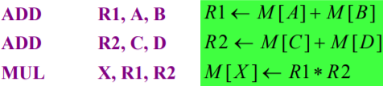
Three-Address Instructions
Computers with three-address instruction formats can use each address field to specify either a processor register or a memory operand.
The program in assembly language that evaluates X = (A + B) * (C + D) is shown below, together with comments that explain the register transfer operation of each instruction.
Operand memory addresses : A, B, C, D
- Result memory address : X
It is assumed that the computer has two processor registers, R1 and R2. The symbol M[A] denotes the operand at memory address symbolized by A.
The advantage of the three-address format is that it results in short programs when evaluating arithmetic expressions.
The disadvantage is that the binary-coded instructions require too many bits to specify three addresses.

Slide 27
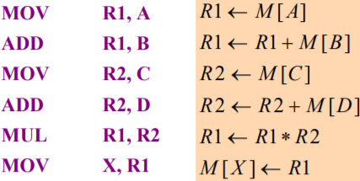
Two-Address Instructions
Two-address instructions are the most common in commercial computers. Here each address field can specify either a processor register or a memory word.
The program to evaluate X = (A + B) * (C + D) is as follows:
The MOV instruction moves or transfers the operands to and from memory and processor registers.
The first symbol listed in an instruction is assumed to be both a source and the destination where the result of the operation is transferred.

Slide 28
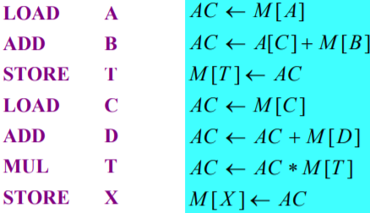
One-Address Instructions
One-address instructions use an implied accumulator (AC) register for all data manipulation. All operations are done between the AC register and memory operand.
For multiplication and division there is a need for a second register. However, here we will neglect the second register and assume that the AC contains the result of all operations.
The program to evaluate X = (A + B) * (C + D) is as follows:
All operations are done between the AC register and a memory operand. T is the address of a temporary memory location required for storing the intermediate result.

Slide 29
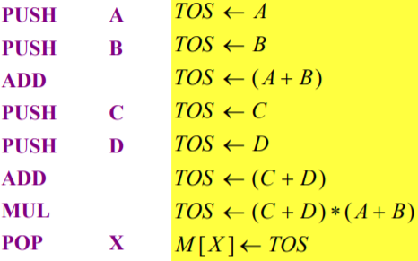
Zero-Address Instructions
A stack-organized computer does not use an address field for the instructions ADD and MUL. The PUSH and POP instructions, however, need an address field to specify the operand that communicates with the stack. The following program shows how X = (A + B) * (C + D) will be written for a stack organized computer. (TOS stands for top of stack.)
To evaluate arithmetic expressions in a stack computer, it is necessary to convert the expression into reverse Polish notation. The name "zero-address" is given to this type of computer because of the absence of an address field in the computational instructions.

Slide 30
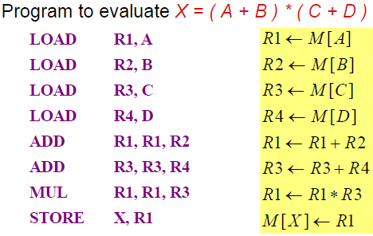
RISC Instruction
Only use LOAD and STORE instruction when communicating between memory and CPU
All other instructions are executed within the registers of the CPU without referring to memory

Slide 31
Thank you

Slide 32
Addressing Modes
Addressing Mode:
1) To give programming versatility to the user
pointers to memory, counters for loop control, indexing of data
2) To reduce the number of bits in the addressing field of the instruction
Instruction Cycle:
1) Fetch the instruction from memory and PC + 1
2) Decode the instruction
3) Execute the instruction
Program Counter (PC):
PC keeps track of the instructions in the program stored in memory
PC holds the address of the instruction to be executed next
PC is incremented each time an instruction is fetched from memory

Slide 33
Addressing Modes
Instruction Format with mode field:
Implied Addressing Mode: Operands are specified implicitly in definition of the instruction
Examples:
COM : Complement Accumulator → Operand in AC is implied in the definition of the instruction
PUSH : Stack push → Operand is implied to be on top of the stack
Immediate Mode: Operand field contains the actual operand. Useful for initializing registers to a constant value
Example : LD #NBR

Slide 34
Addressing Modes
Register Mode: Operands are in registers. Register is selected from a register field in the instruction. k-bit register field can specify any one of 2k registers
Example: LD R1 ; AC ← R1
Register Indirect Mode: Selected register contains the address of the operand rather than the operand itself. Address field of the instruction uses fewer bits to select a memory address
Example: LD (R1) ; AC ← M[R1]
Autoincrement or Autodecrement Mode: Similar to the register indirect mode except that
the register is incremented after its value is used to access memory
the register is decrement before its value is used to access memory
Example: (Autoincrement) : LD (R1)+ ; AC ← M[R1], R1← R1 + 1

Slide 35
Addressing Modes
Direct Addressing Mode: Effective address is equal to the address field of the instruction (Operand). Address field specifies the actual branch address in a branch-type instruction
Example : LD ADR ; AC ← M[ADR]
Indirect Addressing Mode: Address field of instruction gives the address where the effective address is stored in memory
Example : LD @ADR ; AC ← M[M[ADR ]]
Relative Addressing Mode: PC is added to the address part of the instruction to obtain the effective address
Example : LD $ADR ; AC ← M[PC + ADR ]

Slide 36
Addressing Modes
Indexed Addressing Mode: XR (Index register) is added to the address part of the instruction to obtain the effective address
Example : LD ADR(XR) ; AC ← M[ADR + XR]
Base Register Addressing Mode: the content of a base register is added to the address part of the instruction to obtain the effective address
Similar to the indexed addressing mode except that the register is now called a base register instead of an index register
index register (XR) : LD ADR(XR) ;AC ← M[ADR + XR] → index register hold an index number that is relative to the address part of the instruction
base register (BR) : LD ADR(BR) ; AC ← M[BR + ADR ] → base register hold a base address, the address field of the instruction gives a displacement relative to this base address

Slide 37
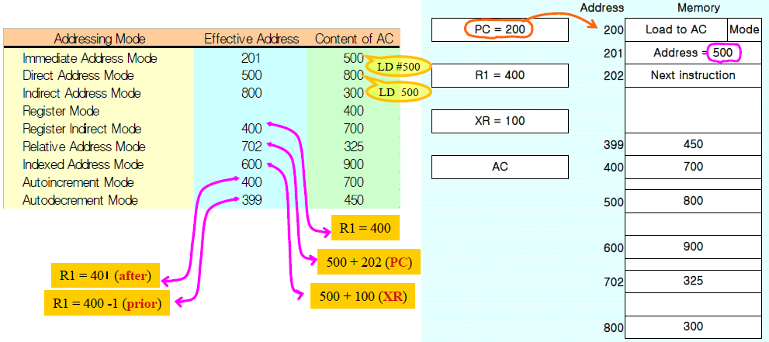
Numerical Example

Slide 38
Data Transfer and Manipulation
Most computer instructions can be classified into three categories:
1. Data transfer instructions
2. Data manipulation instructions
3. Program control instructions
Data transfer instructions cause transfer of data from one location to another without changing the binary information content.
Data manipulation instructions perform arithmetic, logic, and shift operations.
Program control instructions provide decision-making capabilities and change the path taken by the program when executed in the computer.
The instruction set of a particular computer determines the register transfer operations and control decisions that are available to the user.

Slide 39
Data Transfer Instructions
Data transfer instructions cause transfer of data from one location to another without changing the information content.
The common transfers may be
between memory and processor registers,
between processor registers and input/output.
between the processor registers themselves.

Slide 40
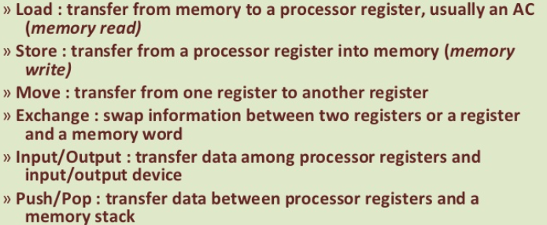
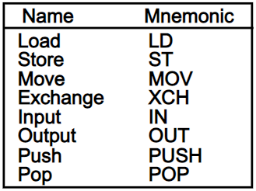
Data Transfer Instructions
Data transfer instructions

Slide 41
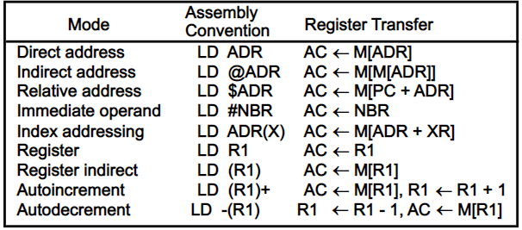
Data Transfer Instructions
Data transfer instructions with different addressing modes
Notes:
ADR stands for an address, NBR is a number or operand, X is an index register, Rl is a
processor register, and AC is the accumulator register. The @ character symbolizes an indirect address.
The $ character before an address makes the address relative to the program counter PC . The # character
precedes the operand in an immediate-mode instruction. An indexed mode instruction is recognized by a
register that is placed in parentheses after the symbolic address. The register mode is symbolized by
giving the name of a processor register. In the register indirect mode, the name of the register that holds
the memory address is enclosed in parentheses.
The autoincrement mode is distinguished from the register indirect mode by placing a plus after the
parenthesized register. The autodecrement mode would use a minus instead

Slide 42
Data Manipulation Instructions
Data manipulation instructions perform operations on data and provide the computational capabilities for the computer.
The data manipulation instructions in a typical computer usually divided into three basic types as follows.
Arithmetic instructions
Logical and bit manipulation instructions
Shift instructions

Slide 43
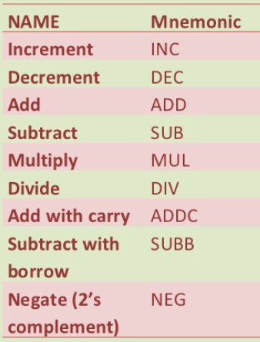
Arithmetic instructions
The four basic arithmetic operations are addition, subtraction, multiplication, and division. Most computers provide instructions for all four operations.

Slide 44
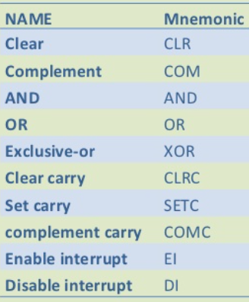
Logical and Bit Manipulation Instructions
Logical instructions perform binary operations on strings of bits stored in registers.
They are useful for manipulating individual bits or a group of bits.

Slide 45
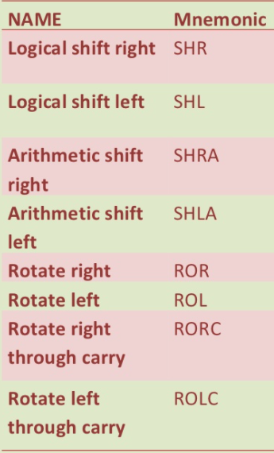
Shift Instructions
Shifts are operations in which the bits of a word are moved to the left or right.
Shift instructions may specify either logical shifts, arithmetic shifts, or rotate-type operations.

Slide 46
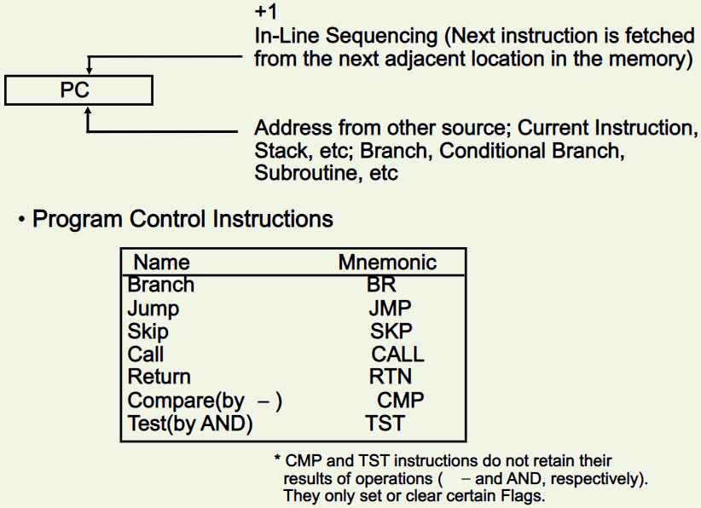
Program control Instructions

Slide 47
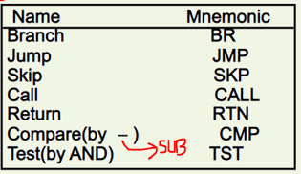
Program control instructions

Slide 48
CALL and RETURN instruction

Slide 49
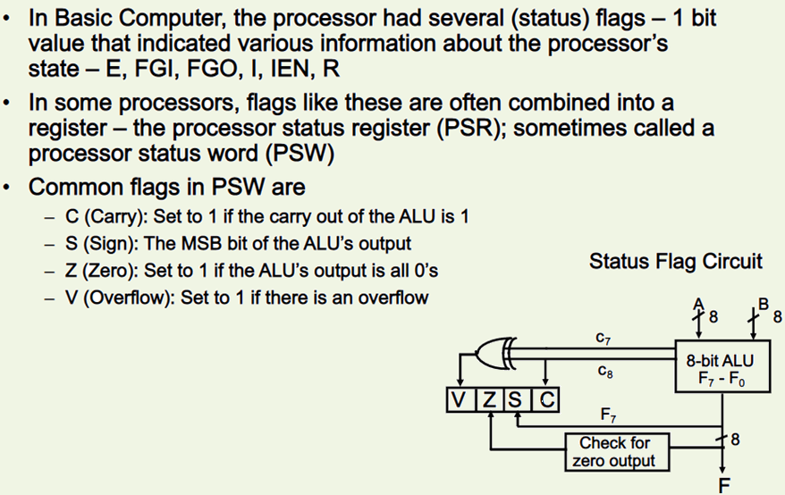
Flag and Processor status word
Let A = 11110000 and B = 00010100.
To perform A - B, the ALU takes the 2's
complement of B and adds it to A .
A : 11110000
B + 1: + 1 1 101 100
A - B: 11011 100 C = 1 s = 1 v = 0 z = 0

Slide 50
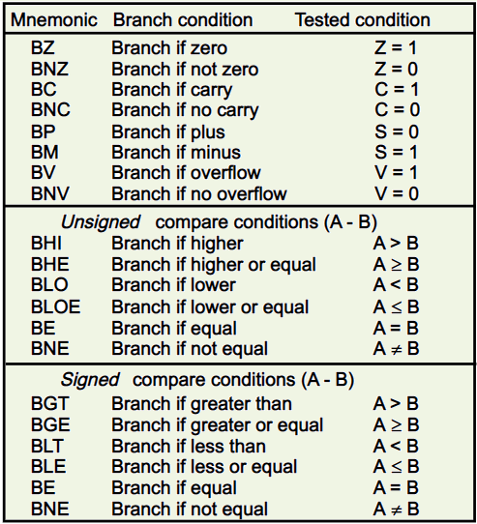
Conditional Branch Instruction
For unsigned numbers:
C Z condition
0 0 A<B
0 1 A = B
1 0 A>B
1 1 A = B
For signed numbers:
S V Condition
0 0 A>B
0 1 A<B
1 0 A<B
1 1 A>B
S (XOR) V =1 ; A<B
=0 ; A>B

Slide 51
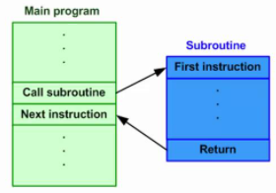
Subroutine CALL and RETURN
The instruction that transfers program control to a subroutine is known by different names. The most common names used are call subroutine, jump to subroutine, branch to subroutine, or branch and save address .
A call subroutine instruction consists of an operation code together with an address that specifies the beginning of the subroutine.
The instruction is executed by performing two operations:
(1) the address of the next instruction available in the program counter (the return address) is stored in a temporary location so the subroutine knows where to return
(2) control is transferred to the beginning of the subroutine. The last instruction of every subroutine, commonly called return from subroutine, transfers the return address from the temporary location into the program counter.

Slide 52
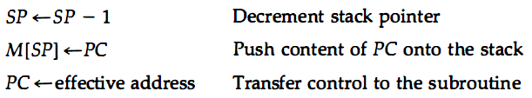
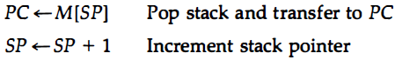
Subroutine CALL and RETURN
CALL microoperations:
RETURN microoperations:

Slide 53
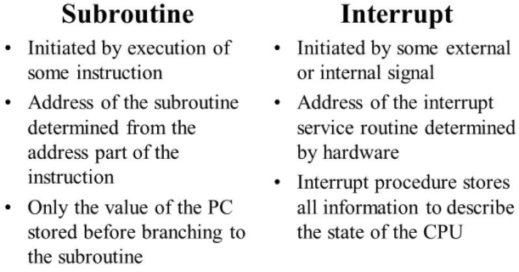
Program Interrupt
An interrupt transfers control from a program that is currently running to another program as a result of externally or internally generated request.
The procedure for servicing the interrupt in this case is called the interrupt service routine (ISR).
Control returns to the original program after the service program is executed.
After a program has been interrupted and the service routine been executed, the CPU must return to exactly the same state that it was when the interrupt
occurred.
rather than storing only the program counter.
It stores PC, all processor registers and PSW

Slide 54
Types of Interrupts
PSW: The collection of all status bit conditions in the CPU is called program status word a program status word or PSW.
The PSW is stored in a separate hardware register and contains the status information that characterizes the state of the CPU.
Typically, it includes the status bits from the last ALU operation and it specifies the interrupts that are allowed to occur and whether the CPU is operating in a supervisor or user mode.
There are three major types of interrupts that cause a break in the normal execution of a program. They can be classified as:
1. External interrupts
2. Internal interrupts
3. Software interrupts

Slide 55
External Interrupts
External interrupts come from
Input-output (l/0) devices
timing device
Circuit monitoring the power supply
any other external source.
Examples that cause external interrupts are
l/0 device requesting transfer of data
l/0 device finished transfer of data
elapsed time of an event (may result from a program that is in an endless loop and thus exceeded its time allocation)
power failure.
External interrupts are asynchronous because they don’t work on clock.

Slide 56
Internal Interrupts (Traps)
Internal interrupts arise from illegal or erroneous use of an instruction or data.
Examples of interrupts caused by internal error conditions like
register overflow
Attempt to divide by zero
invalid operation code
stack overflow
protection violation.
These error conditions usually occur as a result of a premature termination of the instruction execution.
Internal interrupts are synchronous with the program

Slide 57
Software interrupt
Software interrupt is a special call instruction that behaves like an interrupt rather than a subroutine call.
The most common use of software interrupt is associated with a supervisor call instruction. This instruction provides means for switching from a CPU user mode to the supervisor mode.
Certain operations in the computer may be assigned to the supervisor mode only, as for example, a complex input or output transfer procedure.
A program written by a user must run in the user mode. When an input or output transfer is required, the supervisor mode is requested by means of a supervisor call instruction.
This instruction causes a software interrupt that stores the old CPU state and brings in a new PSW that belongs to the supervisor mode.
The calling program must pass information to the operating system in order to specify the particular task requested.

Slide 58
Thank you

Slide 59
Parallel Processing
Parallel processing is a term used to denote a large class of techniques that are used to provide simultaneous data-processing tasks for the purpose of increasing the computational speed of a computer system.
Instead of processing each instruction sequentially as in a conventional computer, a parallel processing system is able to perform concurrent data processing to achieve faster execution time.
For example, while an instruction is being executed in the ALU, the next instruction can be read from memory.
The system may have two or more ALUs and be able to execute two or more instructions at the same time, and the system may have two or more processors operating concurrently.
The purpose of parallel processing is to speed up the computer processing capability and increase its throughput, that is, the amount of processing that can be accomplished during a given interval of time.

Slide 60
Parallel Processing
The amount of hardware increases with parallel processing and with it, the cost of the system increases.
However, technological developments have reduced hardware costs to the point where parallel processing techniques are economically feasible.
We distinguish between parallel and serial operations by the type of registers used.
Shift registers operate in serial fashion one bit at a time, while registers with parallel load operate with all the bits of the word simultaneously

Slide 61
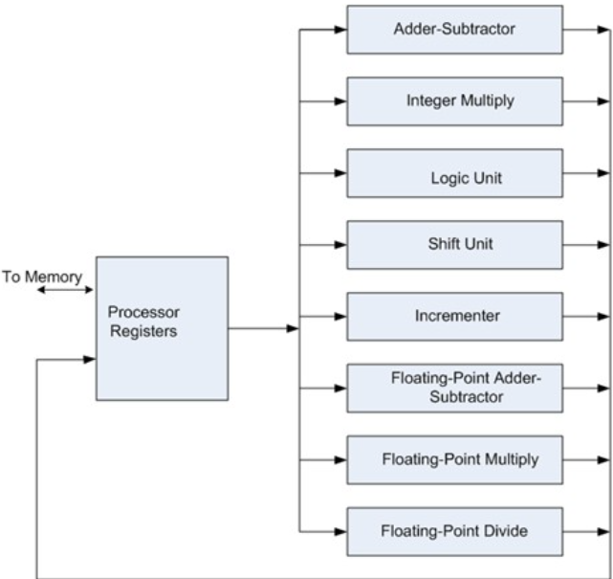
Parallel Processing
Figure shows example of parallel processing.
Multiple functional unit: separate the execution unit into eight functional units operating in parallel.
The operands in the registers are applied to one of the units depending on the operation specified by the instruction associated with the operands.
All units are independent of each other, so one number can be shifted while another number is being incremented.
A multifunctional organization is usually associated with a complex control unit to coordinate all the activities among the various components.

Slide 62
Classification of Parallel Processing
One classification introduced by M. J. Flynn considers the organization of a computer system by the number of instructions and data items that are manipulated simultaneously. The normal operation of a computer is to fetch instructions from memory and execute them in the processor.
The sequence of instructions read from memory constitutes an instruction stream . The operations performed on the data in the processor constitutes a data stream .
Parallel processing may occur in the instruction stream, in the data stream, or in both. Flynn's classification divides computers into four major groups as follows:
Single instruction stream, single data stream (SISD)
Single instruction stream, multiple data stream (SIMD)
Multiple instruction stream, single data stream (MISD)
Multiple instruction stream, multiple data stream (MIMD)

Slide 63
Classification of Parallel Processing
SISD represents the organization of a single computer containing a control unit, a processor unit, and a memory unit.
Instructions are executed sequentially and the system may or may not have internal parallel processing capabilities.
Parallel processing in this case may be achieved by means of multiple functional units or by pipeline processing.
SIMD represents an organization that includes many processing units under the supervision of a common control unit.
All processors receive the same instruction from the control unit but operate on different items of data. The shared memory unit must contain multiple modules so that it can communicate with all the processors simultaneously.

Slide 64
Classification of Parallel Processing
MISD structure is only of theoretical interest since no practical system has been constructed using this organization.
MIMD organization refers to a computer system capable of processing several programs at the same time. Most multiprocessor and multicomputer systems can be classified in this category.
Flynn's classification depends on the distinction between the performance of the control unit and the data-processing unit.
It emphasizes the behavioural characteristics of the computer system rather than its operational and structural interconnections.
Types of parallel Processing:
1. Pipeline processing
2. Vector processing
3. Array processors

Slide 65
Pipelining
Pipelining is a technique of decomposing a sequential process into suboperations, with each subprocess being executed in a special dedicated segment that operates concurrently with all other segments.
A pipeline can be visualized as a collection of processing segments through which binary information flows. Each segment performs partial processing dictated by the way the task is partitioned.
The result obtained from the computation in each segment is transferred to the next segment in the pipeline. The final result is obtained after the data have passed through all segments.
The name "pipeline" implies a flow of information analogous to an industrial assembly line.
It is characteristic of pipelines that several computations can be in progress in distinct segments at the same time. The overlapping of computation is made possible by associating a register with each segment in the pipeline.
The registers provide isolation between each segment so that each can operate on distinct data simultaneously.

Slide 66
Pipelining
Perhaps the simplest way of viewing the pipeline structure is to imagine that each segment consists of an input register followed by a combinational circuit. The register holds the data and the combinational circuit performs the suboperation in the particular segment.
The output of the combinational circuit in a given segment is applied to the input register of the next segment. A clock is applied to all registers after enough time has elapsed to perform all segment activity. In this way the information flows through the pipeline one step at a time.
The pipeline organization will be demonstrated by means of a simple example. Suppose that we want to perform the combined multiply and add operations with a stream of numbers. A_{i} * B_{i} + C_{i} for i = 1, 2, 3, . .. , 7
Each suboperation is to be implemented in a segment within a pipeline. Each segment has one or two registers and a combinational circuit as shown in Fig. 2. R1 through R5 are registers that receive new data with every clock pulse. The multiplier and adder are combinational circuits. The suboperations performed in each segment of the pipeline are as follows:

Slide 67
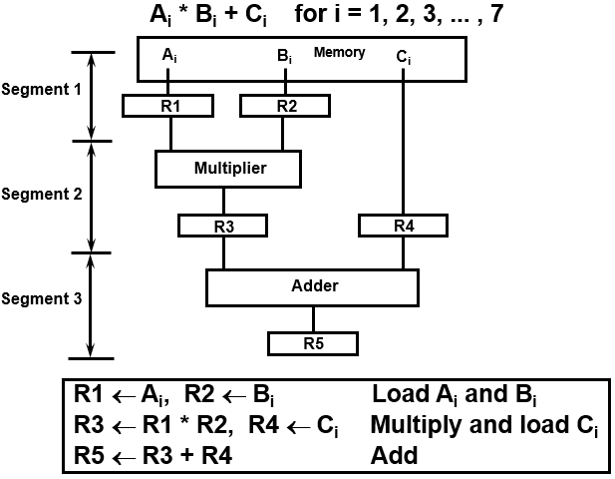
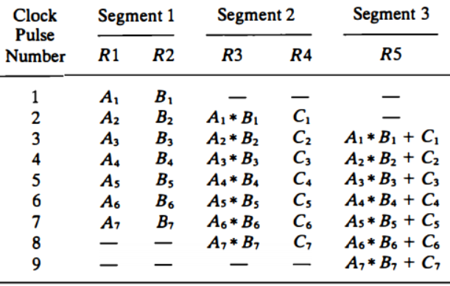
Pipelining

Slide 68
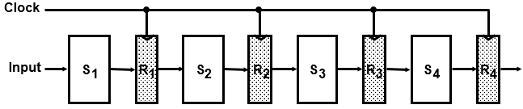
Four segment Pipeline

Slide 69
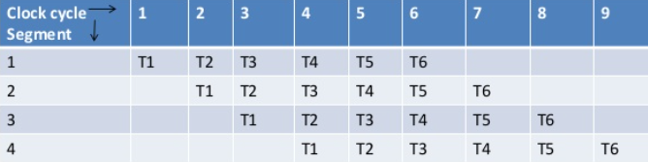
Space-Time diagram for pipeline
k-segment pipeline with a clock cycle time t_{p} is used to execute n tasks.
The first task T1 requires a time equal to kt_{p} to complete its operation since there are k segments in the pipe. The remaining n - 1 tasks emerge from the pipe at the rate of one task per clock cycle and they will be completed after a time equal to (n - 1)t_{p}.
Therefore, to complete n tasks using a k-segment pipeline requires k + (n - 1) clock cycles. For example, the diagram of Fig. 4 shows four segments and six tasks. The time required to complete all the operations is 4 + (6 - 1) = 9 clock cycles, as indicated in thediagram.

Slide 70
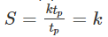
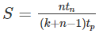
Space-Time diagram for pipeline
Next consider a nonpipeline unit that performs the same operation and takes a time equal to tn. to complete each task. The total time required for n tasks is ntn.
The speedup of a pipeline processing over an equivalent nonpipeline processing is defined by the ratio
As the number of tasks increases, n becomes much larger than k - 1, and k + n - 1 approaches the value of n. Under this condition, the speedup becomes S=tn / tp
If we assume that the time it takes to process a task is the same in the pipeline and non pipeline circuits, we will have tn = ktp. Including this assumption, the speedup reduces to

Slide 71
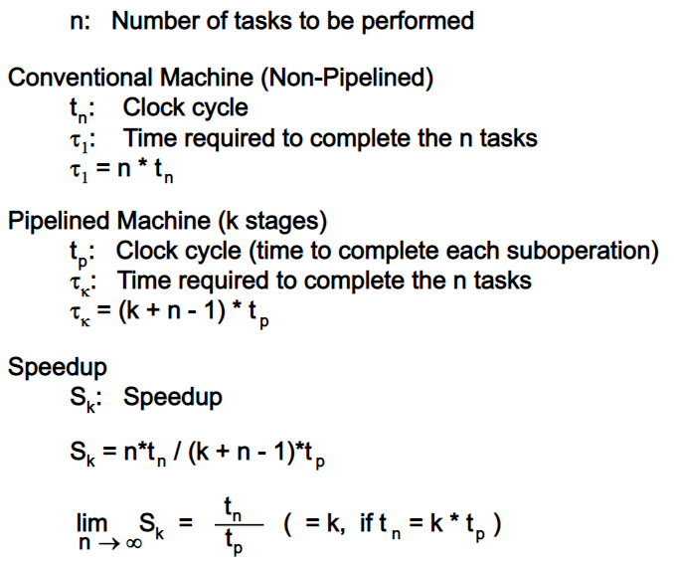
Space-Time diagram for pipeline
This shows that the theoretical maximum speedup that a pipeline can provide is k, where k is the number of segments in the pipeline.

Slide 72
Pipeline- Example
Let the time it takes to process a suboperation in each segment be equal to tp = 20 ns. Assume that the pipeline has k = 4 segments and executes n = 100 tasks in sequence.
The pipeline system will take (k + n - 1)tp = (4 + 99) x 20 = 2060 ns to complete.
Assuming that tn = ktp = 4 x 20 = 80 ns,
a non pipeline system requires nktp = 100 x 80 = 8000 ns to complete the 100 tasks.
The speedup ratio is equal to 8000/2060 = 3 .88.
As the number of tasks increases, the speedup will approach 4, which is equal to the number of segments in the pipeline.
If we assume that tn = 60 ns, the speedup becomes 60/20 = 3 .

Slide 73
Arithmetic Pipeline
Pipeline arithmetic units are usually found in very high speed computers. They are used to implement floating-point operations, multiplication of fixed-point numbers, and similar computations encountered in scientific problems.
A pipeline multiplier is essentially an array multiplier, with special adders designed to minimize the carry propagation time through the partial products.
Floating-point operations are easily decomposed into suboperations.
The inputs to the floating-point adder pipeline are two normalized floating-point binary numbers.
X = A * 2ª; Y = B * 2^{b}
where A and B are two fractions that represent the mantissas and a and b are the exponents.

Slide 74
Arithmetic Pipeline
The floating-point addition and subtraction can be performed in four segments, as shown in Fig.
The registers labeled R are placed between the segments to store intermediate results.
The suboperations that are performed in the four segments are:
1. Compare the exponents.
2. Align the mantissas.
3. Add or subtract the mantissas.
4. Normalize the result.

Slide 75
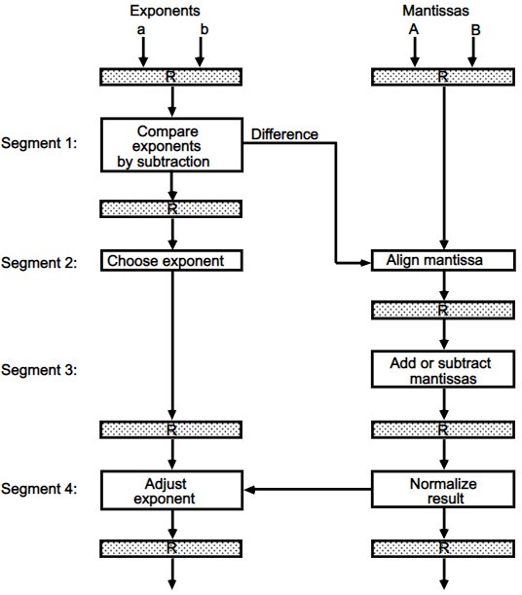
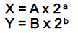
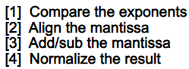
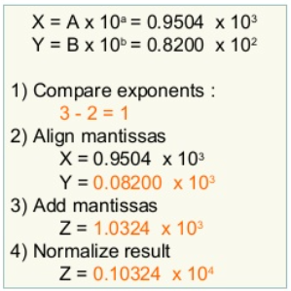
Arithmetic Pipeline

Slide 76
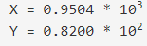
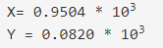
Arithmetic Pipeline
Consider the two normalized floating-point numbers:
The two exponents are subtracted in the first segment to obtain 3 - 2 = 1. The larger exponent 3 is chosen as the exponent of the result. The next segment shifts the mantissa of Y to the right to obtain
The addition of the two mantissas in segment 3 produces the sum Z = 1 .0324 * 10³
The sum is adjusted by normalizing the result so that it has a fraction with a nonzero first digit. This is done by shifting the mantissa once to the right and incrementing the exponent by one to obtain the normalized sum. Z = 0.10324 * 10⁴

Slide 77
Arithmetic Pipeline
The comparator, shifter, adder- subtractor, incrementer, and decrementer in the floating-point pipeline are implemented with combinational circuits. Suppose that the time delays of the four segments are t₁ = 60 ns, t₂ = 70 ns, t₃ = 100 ns, t₄ = 80 ns, and the interface registers have a delay of t_{r} = 10 ns.
The clock cycle is chosen to be t_{p} = t₃ + t_{r} = 110 ns.
An equivalent nonpipeline floatingpoint adder-subtractor will have a delay time
t_{n} = t₁ + t₂ + t₃ + t₄ + t_{r} = 320 ns.
In this case the pipelined adder has a speedup of 320/110 = 2.9 over the nonpipelined adder.

Slide 78
Instruction Pipeline
Pipeline processing can occur not only in the data stream but in the instruction stream as well.
An instruction pipeline reads consecutive instructions from memory while previous instructions are being executed in other segments. This causes the instruction fetch and execute phases to overlap and perform simultaneous operations.
One possible digression associated with such a scheme is that an instruction may cause a branch out of sequence. In that case the pipeline must be emptied and all the instructions that have been read from memory after the branch instruction must be discarded.
Consider a computer with an instruction fetch unit and an instruction execution unit designed to provide a two-segment pipeline. The instruction fetch segment can be implemented by means of a first-in, first-out (FIFO) buffer. This is a type of unit that forms a queue rather than a stack.
Whenever the execution unit is not using memory, the control increments the program counter and uses its address value to read consecutive instructions from memory. The instructions are inserted into the FIFO buffer so that they can be executed on a first-in, first-out basis.

Slide 79
Instruction Pipeline
Thus an instruction stream can be placed in a queue, waiting for decoding and processing by the execution segment. The instruction stream queuing mechanism provides an efficient way for reducing the average access time to memory for reading instructions.
Whenever there is space in the FIFO buffer, the control unit initiates the next instruction fetch phase.
The buffer acts as a queue from which control then extracts the instructions for the execution unit.
Computers with complex instructions require other phases in addition to the fetch and execute to process an instruction completely. In the most general case, the computer needs to process each instruction with the following sequence of steps.
1. Fetch the instruction from memory. 2. Decode the instruction.
3. Calculate the effective address. 4. Fetch the operands from memory.
5. Execute the instruction. 6. Store the result in the proper place.

Slide 80
Instruction Pipeline
There are certain difficulties that will prevent the instruction pipeline from operating at its maximum rate. Different segments may take different times to operate on the incoming information.
Some segments are skipped for certain operations. For example, a register mode instruction does not need an effective address calculation.
Two or more segments may require memory access at the same time, causing one segment to wait until another is finished with the memory.
Memory access conflicts are sometimes resolved by using two memory buses for accessing instructions and data in separate modules. ln this way, an instruction word and a data word can be read simultaneously from two different modules.
The design of an instruction pipeline will be most efficient if the instruction cycle is divided into segments of equal duration. The time that each step takes to fulfill its function depends on the instruction and the way it is executed.

Slide 81
Four-Segment Instruction Pipeline
The decoding of the instruction can be combined with the calculation of the effective address into one segment.
Most of the instructions place the result into a processor register so that the instruction execution and storing of the result can be combined into one segment. This reduces the instruction pipeline into four segments.
The effective address may be calculated in a separate arithmetic circuit for the third instruction, and whenever the memory is available, the fourth and all subsequent instructions can be fetched and placed in an instruction FIFO.
Thus up to four suboperations in the instruction cycle can overlap and up to four different instructions can be in progress of being processed at the same time.

Slide 82
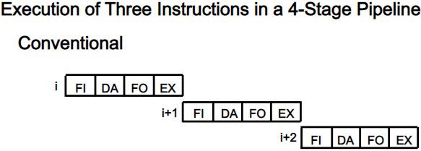
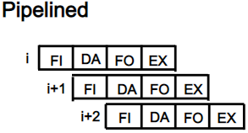
Four-Segment Instruction Pipeline

Slide 83
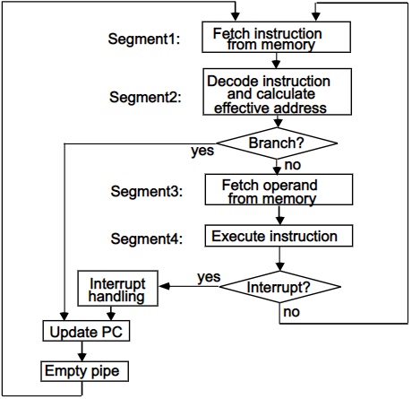
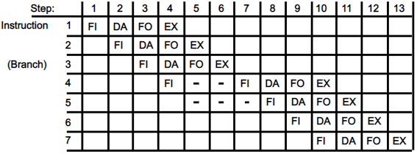
Four-Segment Instruction Pipeline
Branch instruction causes the pending operations in the last two segments are completed and all information stored in the instruction buffer is deleted.
The pipeline then restarts from the new address stored in the program counter.
Notes:
Assume now that instruction 3 is a branch instruction. As soon as this instruction is decoded in segment DA in step 4, the transfer from FI to DA of the other instructions is halted until the branch instruction is executed in step 6. If the branch is taken, a new instruction is fetched in step 7. If the branch is not taken, the instruction fetched previously in step 4 can be used. The pipeline then continues until a new branch instruction is encountered.
Another delay may occur in the pipeline if the EX segment needs to store the result of the operation in the data memory while the FO segment needs to fetch an operand. In that case, segment FO must wait until segment EX has finished its operation.

Slide 84
Pipeline Conflicts
There are three major difficulties that cause the instruction pipeline to deviate from its normal operation.
Resource conflicts caused by access to memory by two segments at the same time. Most of these conflicts can be resolved by using separate instruction and data memories.
Data dependency conflicts arise when an instruction depends on the result of a previous instruction, but this result is not yet available.
Branch difficulties arise from branch and other instructions that change the value of PC .

Slide 85
Hazards in Pipeline
There are three major difficulties that cause the instruction pipeline to deviate from its normal operation.
Structural Hazards
Data Hazards
Control Hazards

Slide 86
Thank you

Slide 87
Computer Arithmetic
Introduction
addition and subtraction
decimal arithmetic unit
Booth’s multiplication algorithm.

Slide 88
Computer Arithmetic
Arithmetic instructions in digital computers manipulate data to produce results necessary for the solution of computational problems.
These instructions perform arithmetic calculations and are responsible for the bulk of activity involved in processing data in a computer.
The four basic arithmetic operations are addition, subtraction, multiplication and division. From these four basic operations, it is possible to formulate other arithmetic functions and solve scientific problems by means of numerical analysis methods.
An arithmetic processor is the part of a processor unit that executes arithmetic operations. An arithmetic instruction may specify binary or decimal data, and in each case the data may be in fixed-point or floating-point form.
Fixed point numbers may represent integers or fractions.
Negative numbers may be in signed magnitude or signed-complement representation.
The arithmetic processor is very simple if only a binary fixed-point add instruction is included. It would be more complicated if it includes all four arithmetic operations for binary and decimal data in fixed-point and floating point representation.

Slide 89
Addition and Subtraction
There are three ways of representing negative fixed-point binary numbers:
signed-magnitude
signed-1's complement
signed-2's complement.
Most computers use the signed-2's complement representation when performing arithmetic operations with integers.
For floating point operations, most computers use the signed-magnitude representation for the mantissa.

Slide 90
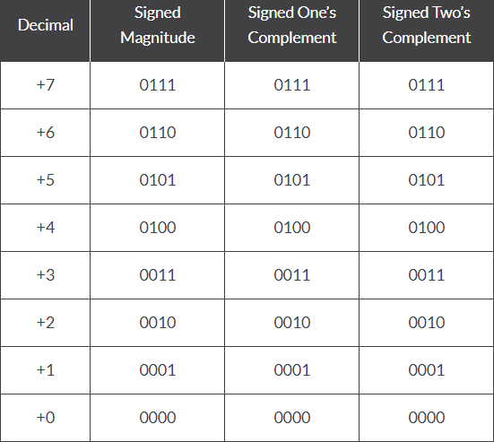
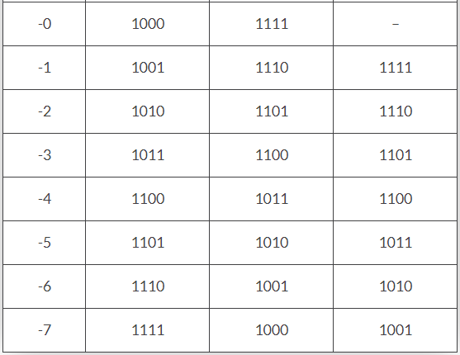
Addition and Subtraction
Signed magnitude form: Signed Magnitude Method : only add an extra sign bit to recognize negative and positive numbers. Sign bit has 1 for negative number and 0 for positive number.
2’s Complement Method : MSB is always Sign bit, MSB is always 1 in case of negative numbers. We only take 1’s complement of negative numbers to represent in the computer.

Slide 91
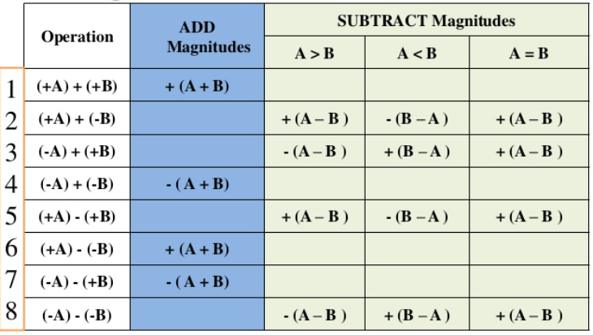
Addition and Subtraction with signed magnitude data
When the signed numbers are added or subtracted, we find that there are eight different conditions to consider, depending on the sign of the numbers and the operation performed. These conditions are listed in the first column of Table. The other columns in the table show the actual operation to be performed with the magnitude of the numbers. The last column is needed to prevent a negative zero. In other words, when two equal numbers are subtracted, the result should be +0 not –0.

Slide 92
Addition and Subtraction with signed magnitude data

Slide 93
Addition and Subtraction with signed magnitude data

Slide 94

Hardware Implementation for signed magnitude addition and subtraction

Slide 95

Hardware Algorithm

Slide 96


Addition and Subtraction
with Signed-2’s Complement Data
Hardware
The sum is obtained by adding the contents of AC and BR (including their sign bits).
The overflow bit V is set to 1 if the exclusive-OR of the last two carries is 1, and it is cleared to 0 otherwise.
The subtraction operation is accomplished by adding the content of AC to the 2's complement of BR. Taking the 2's complement of BR has the effect of changing a positive number to negative, and vice versa.
An overflow must be checked during this operation because the two numbers added could have the same sign. The programmer must realize that if an overflow occurs, there will be an erroneous result in the AC register.
Algorithm

Slide 97
Thank you

Slide 98
Decimal Arithmetic Unit
The user of a computer prepares data with decimal numbers and receives results in decimal form.
A CPU with an arithmetic logic unit can perform arithmetic micro-operations with binary data.
To perform arithmetic operations with decimal data, it is necessary to convert the input decimal numbers to binary, to perform all calculations with binary numbers, and to convert the results into decimal.

Slide 99


BCD Adder

Slide 100
BCD Adder

Slide 101
BCD Subtraction
It is more economical to perform the subtraction by taking the 9's or 10's complement of the subtrahend and adding it to the minuend.
The 9's complement of a decimal digit represented in BCD may be obtained by complementing the bits in the coded representation of the digit provided a correction is included.
There are two possible correction methods.
In the first method, binary 1010 (decimal 10) is added to each complemented digit and the carry discarded after each addition.
In the second method, binary 0110 (decimal 6) is added before the digit is complemented.

Slide 102


BCD Subtraction

Slide 103

BCD Subtraction

Slide 104



One stage Decimal Arithmetic Unit
When M = 0, x = B
When M = 1, x = 9' s complement of B
The best way to subtract the two decimal numbers is to let M = 1 and apply a 1 to the input carry C1 of the first stage. The outputs will form the sum of A plus the 10's complement of B, which is equivalent to a subtraction operation if the carry-out of the last stage is discarded.

Slide 105
Thank you

Slide 106
Booth Multiplication Algorithm
Booth algorithm gives a procedure for multiplying binary integers in signed 2’s complement representation.
It operates on the fact that strings of 0’s in the multiplier require no addition but just shifting, and a string of 1‘s in the multiplier from bit weight 2^{k} to 2^{m} can be treated 2^{k+1} -2^{m}.
for example for binary number 001110(+14) when (k=3, m=1), the number can be represented as 2^{k+1} -2^{m} = 2⁴ - 2¹ = 16- 2=14.
Therefore, the multiplication M x 14, where M is the multiplicand and 14 the multiplier, can be done as M 2⁴ - M2¹. Thus the product can be obtained by shifting the binary multiplicand M four times to the left and subtracting M shifted left once.

Slide 107
Booth Multiplication Algorithm
Booth algorithm requires examination of the multiplier bits and shifting of the partial product.
Prior to the shifting, the multiplicand may be added to the partial product, subtracted from the partial product, or left unchanged according to the following rules:
1. The multiplicand is subtracted from the partial product upon encountering the first least significant 1 in a string of 1‘s in the multiplier.
2. The multiplicand is added to the partial product upon encountering the first 0 (provided that there was a previous 1) in a string of 0‘s in the multiplier.
3. The partial product does not change when the multiplier bit is identical to the previous multiplier bit.

Slide 108

Hardware Implementation of
Booth Algorithm
Qn designates the least significant bit of multiplier in the register QR.
An extra flip-flop Qn+1is appended to QR to facilitate a double inspection of the multiplier.

Slide 109

Booth Multiplication
Algorithm
A numerical example of Booth algorithm is shown in Table for n = 5.
It shows the step-by-step multiplication of ( - 9) x ( - 13) = + 117.
Note that the multiplier in QR is negative and that the multiplicand in BR is also negative. The 10-bit product appears in AC and QR and is positive.
The final value of Qn+1 is the original sign bit of the multiplier and should not be taken as part of the product.

Slide 110

Example of Multiplication with
Booth Algorithm
A numerical example of Booth algorithm is shown in Table for n = 5.
It shows the step-by-step multiplication of ( - 9) x ( - 13) = + 117.
Note that the multiplier in QR is negative and that the multiplicand in BR is also negative. The 10-bit product appears in AC and QR and is positive.
The final value of Qn+1 is the original sign bit of the multiplier and should not be taken as part of the product.

Slide 111
Thank you

